Slide 1
Introduction to Information Security

Slide 2
INFORMATION SECURITY
DATA | INFORMATION | SECURITY
Data: Raw Facts
Information: Processed data or collection of data
Information Security: Covering up all the security aspects related to Information Technology

Slide 3
Data is placed in?
Network
Desktop
Mobile
Web Application
Websites
Etc.

Slide 4
Security Triangle
Security
Ease of Access
Functionality

Slide 5
CIA TRIAD
1. CONFIDENTIALITY
2. INTEGRITY
3. AVAILABILITY
That the data which is confidential and private should be secured from bad people.
Dis-manipulation of data which should be secured from others. - accuracy.
Availability simply means that some data should be available to specific persons only having access rights.
eg. - Aadhar Cards, Financial Records etc.
e.g. changing of any sensitive personal document.

Slide 6
ETHICAL HACKING / CYBER SECURITY
Ethical
Hacking
Hackers
Means legal practices which should be performed.
Hacking means accessing any data, information or any system with the permission of individual.
Hackers are the most skilled and technical people who are proficient in understanding the technical aspects.

Slide 7
TYPES OF HACKERS
1. BLACK HAT HACKERS -
usually comes in newspaper
Eg. Shadow Brokers
2. WHITE HAT HACKERS -
3. GREY HAT HACKERS -
Eg. Anonymous, Edward Snowden etc.
These are the bad people who access and gain resources of any individual for the sake of there own wealth.
These are those people who gains access and tamper the resource for the sake of the individual.
E.g. I and U
These are those hackers who hacks and gains resources for the sake of the society and culture.

Slide 8
BLACK HAT HACKERS –
Example 1.
NSA (National Security Agency, USA) tools were leaked to entire internet
NSA has repository which was leaked by shadow brokers on WikiLeaks
Check what is WikiLeaks??
Who is founder of WikiLeaks?
Task: Movie – The Fifth Estate- do watch
Julian Assange (he is now house arrest)

Slide 9
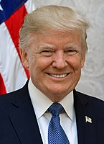
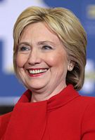
BLACK HAT HACKERS –
Example 2.
In 2016 United States Hillary Clinton and Trump were nominated for presidential election
Chances of Clinton were high to win the elections
But later her account (Email) was hacked
Russia has finest hackers
Trump send shares to them as ransom
Then what happened??
She had some negative things in her mail against trump. These mails were all leaked out.

Slide 10
BLACK HAT HACKERS –
Example 3
Who was the first person to land on moon??
Neil Armstrong ??
But documentaries are available that he did not land first.
Some other person did
Task: Find out Who was that person?

Slide 11
3. Grey HAT HACKERS
Example 1.
US is spying on everyone
This information was leaked by Edward Snowden
He told US is spying on us.
He is now taken care by Russia
He is good or bad ???
Bad for US (Black hat)
Depends upon perspective
Good for others (hero- white hat)

Slide 12
3. Grey HAT HACKERS
Example
He is still working on UIDIA (adhaar card)
He comes up with skype calls in front of people.
He has also given TedX talk but on skype

Slide 13
Other Categories
1. Script Kiddies
2. Noobz
3. Crackers
Who steals the programs, ideas or any other method of hacking and perform hacks without any knowledge.
New born technical babies who just arrived in the field of cyber security.
Who are good in cracking into a particular machine or a authentication check,
they crack into systems for a malicious purpose

Slide 14
TYPES OF INFORMATION
1. Confidential Information
2. Financial Information
3. Health Information
4. Personal Information
Aadhar Cards, Passwords, Birth Certificates, PAN Cards etc.
Financial Statements, Bank Details, Login Credentials for banking practices etc.
Policies, Diseases etc.
Address, Phone Numbers, DOBs etc.

Slide 15
Why do people Hack?? MOTIVE??
1.Hobby
2.Defame (Revenge)
3.Stealing information
4.Leaking information
5.Political motives
6. SECURTIY REASONS i.e. securing digital space :)

Slide 16
Cyber Terrorism
Terrorist have found a new way for indulging into disruptive activities through digital space.
Email conversation ---> telephonic conversation --> gaming platform.
Cyber terrorism means to damage information, computer systems and
data that result in harm against non-combatant targets.

Slide 17
Cyber terrorism
CASE 26/11 ---> NATGrid formation
In attack of 26/11 Some people knew few information but they did not share data with anyone
So formation of NATgrid
So that everyone can share with NATgrid and on basis of information it will be decided what and with whom to share

Slide 18
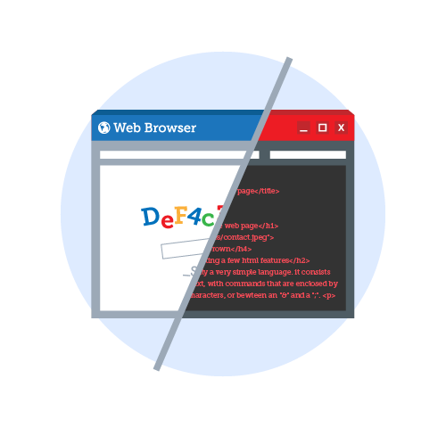
Defacement
What is defacement??
E.g: Happy birthday Pooja
In Jamia Milia Islamia webpage

Slide 19
Cyber Laws
** Section 43:
Penalty and compensation for damage to computer and computer system.
** Section 65:
Tempering with computer source Documents.
Changing and altering the documents which are available.

Slide 20
Cyber Laws
Imprisonment upto 3 years and Fine upto 200,000 INR.
** Section 66: Computer Related Offences.
**SECTION 66 A - Punishment for sending offensive messages through communication service.
Imprisonment upto 3 years and Fine upto 100,000 INR or both.
**SECTION 66 B - Dishonestly receiving and retaining any stolen computer resource or communication device is also made punishable by amendment.
Imprisonment upto 3 years and Fine upto 100,000 INR or both.

Slide 21
Cyber Laws
**SECTION 66 C - Identity Theft (Driving license, adhar card etc)
Imprisonment upto 3 years and Fine upto 100,000 INR or both.
**SECTION 66 D - Cheating by Personation by using computer resource or communication device. (telecallers)
Imprisonment upto 3 years and Fine upto 100,000 INR or both.
**SECTION 66 E - Violation of Privacy
Imprisonment upto 3 years and Fine upto 200,000 INR or both.

Slide 22
Cyber Laws
**SECTION 66 F - Punishment to cyber terrorism
Data or computer database so obtained may be used to cause or likely to cause injury to the interests of the sovereignty and integrity of India, the security of the State, friendly relations with foreign States, public order, decency or morality, or in relation to contempt of court, defamation or incitement to an offence, or to the advantage of any foreign nation, group of individuals or otherwise, commits the offence of cyber terrorism.
** Section 67: Punishment for publishing or transmitting obscene material in electronic from.

Slide 23
Cyber Laws
** Section 71: Penalty for misrepresentation.
If you have uploaded your ID card, and given the wrong name and address,then again it is a crime.
Imprisonment to Two years, or with fine of 1,00,000 INR, or with both.
** Section 72: Breaching of Confidentiality and Privacy
I have some personal stuff in my hard disk drive and on google drive, If someone any how gets the access of those files without my permission, Then again it is a crime.
Right To Privacy.
Imprisonment for Ten Years, or with fine, or with both.

Slide 24
Cyber Laws
** Section 73: Penalty for publishing electronic signature certificate false in certain particular. Signature Forgery.
Imprisonment for upto two years, or with fine upto 1,00,000 INR, or with both.

Slide 25
TASKS
Follow
TheHackernews.com
Gbhackers.com
tools, courses, tutorials
Movie on
Edward Snowden
Social engineering-Kevin Mitnick (
TAKEDOWN)
(technical details)
(Snowden)

Slide 26
TASKS
Who looks after security of google
Parissa Tabriz (girl)
She is also known as security princess of google
Helpful link: https://lucideustech.blogspot.com/2018/02/a-basic-guide-to-indian-it-amendment.html

Slide 27
LMS
Key JAN2020

